Slide 1
A GUIDE TO TEAM FUNDRAISING

Slide 2
PART I – GETTING STARTED VIDEO

Slide 3
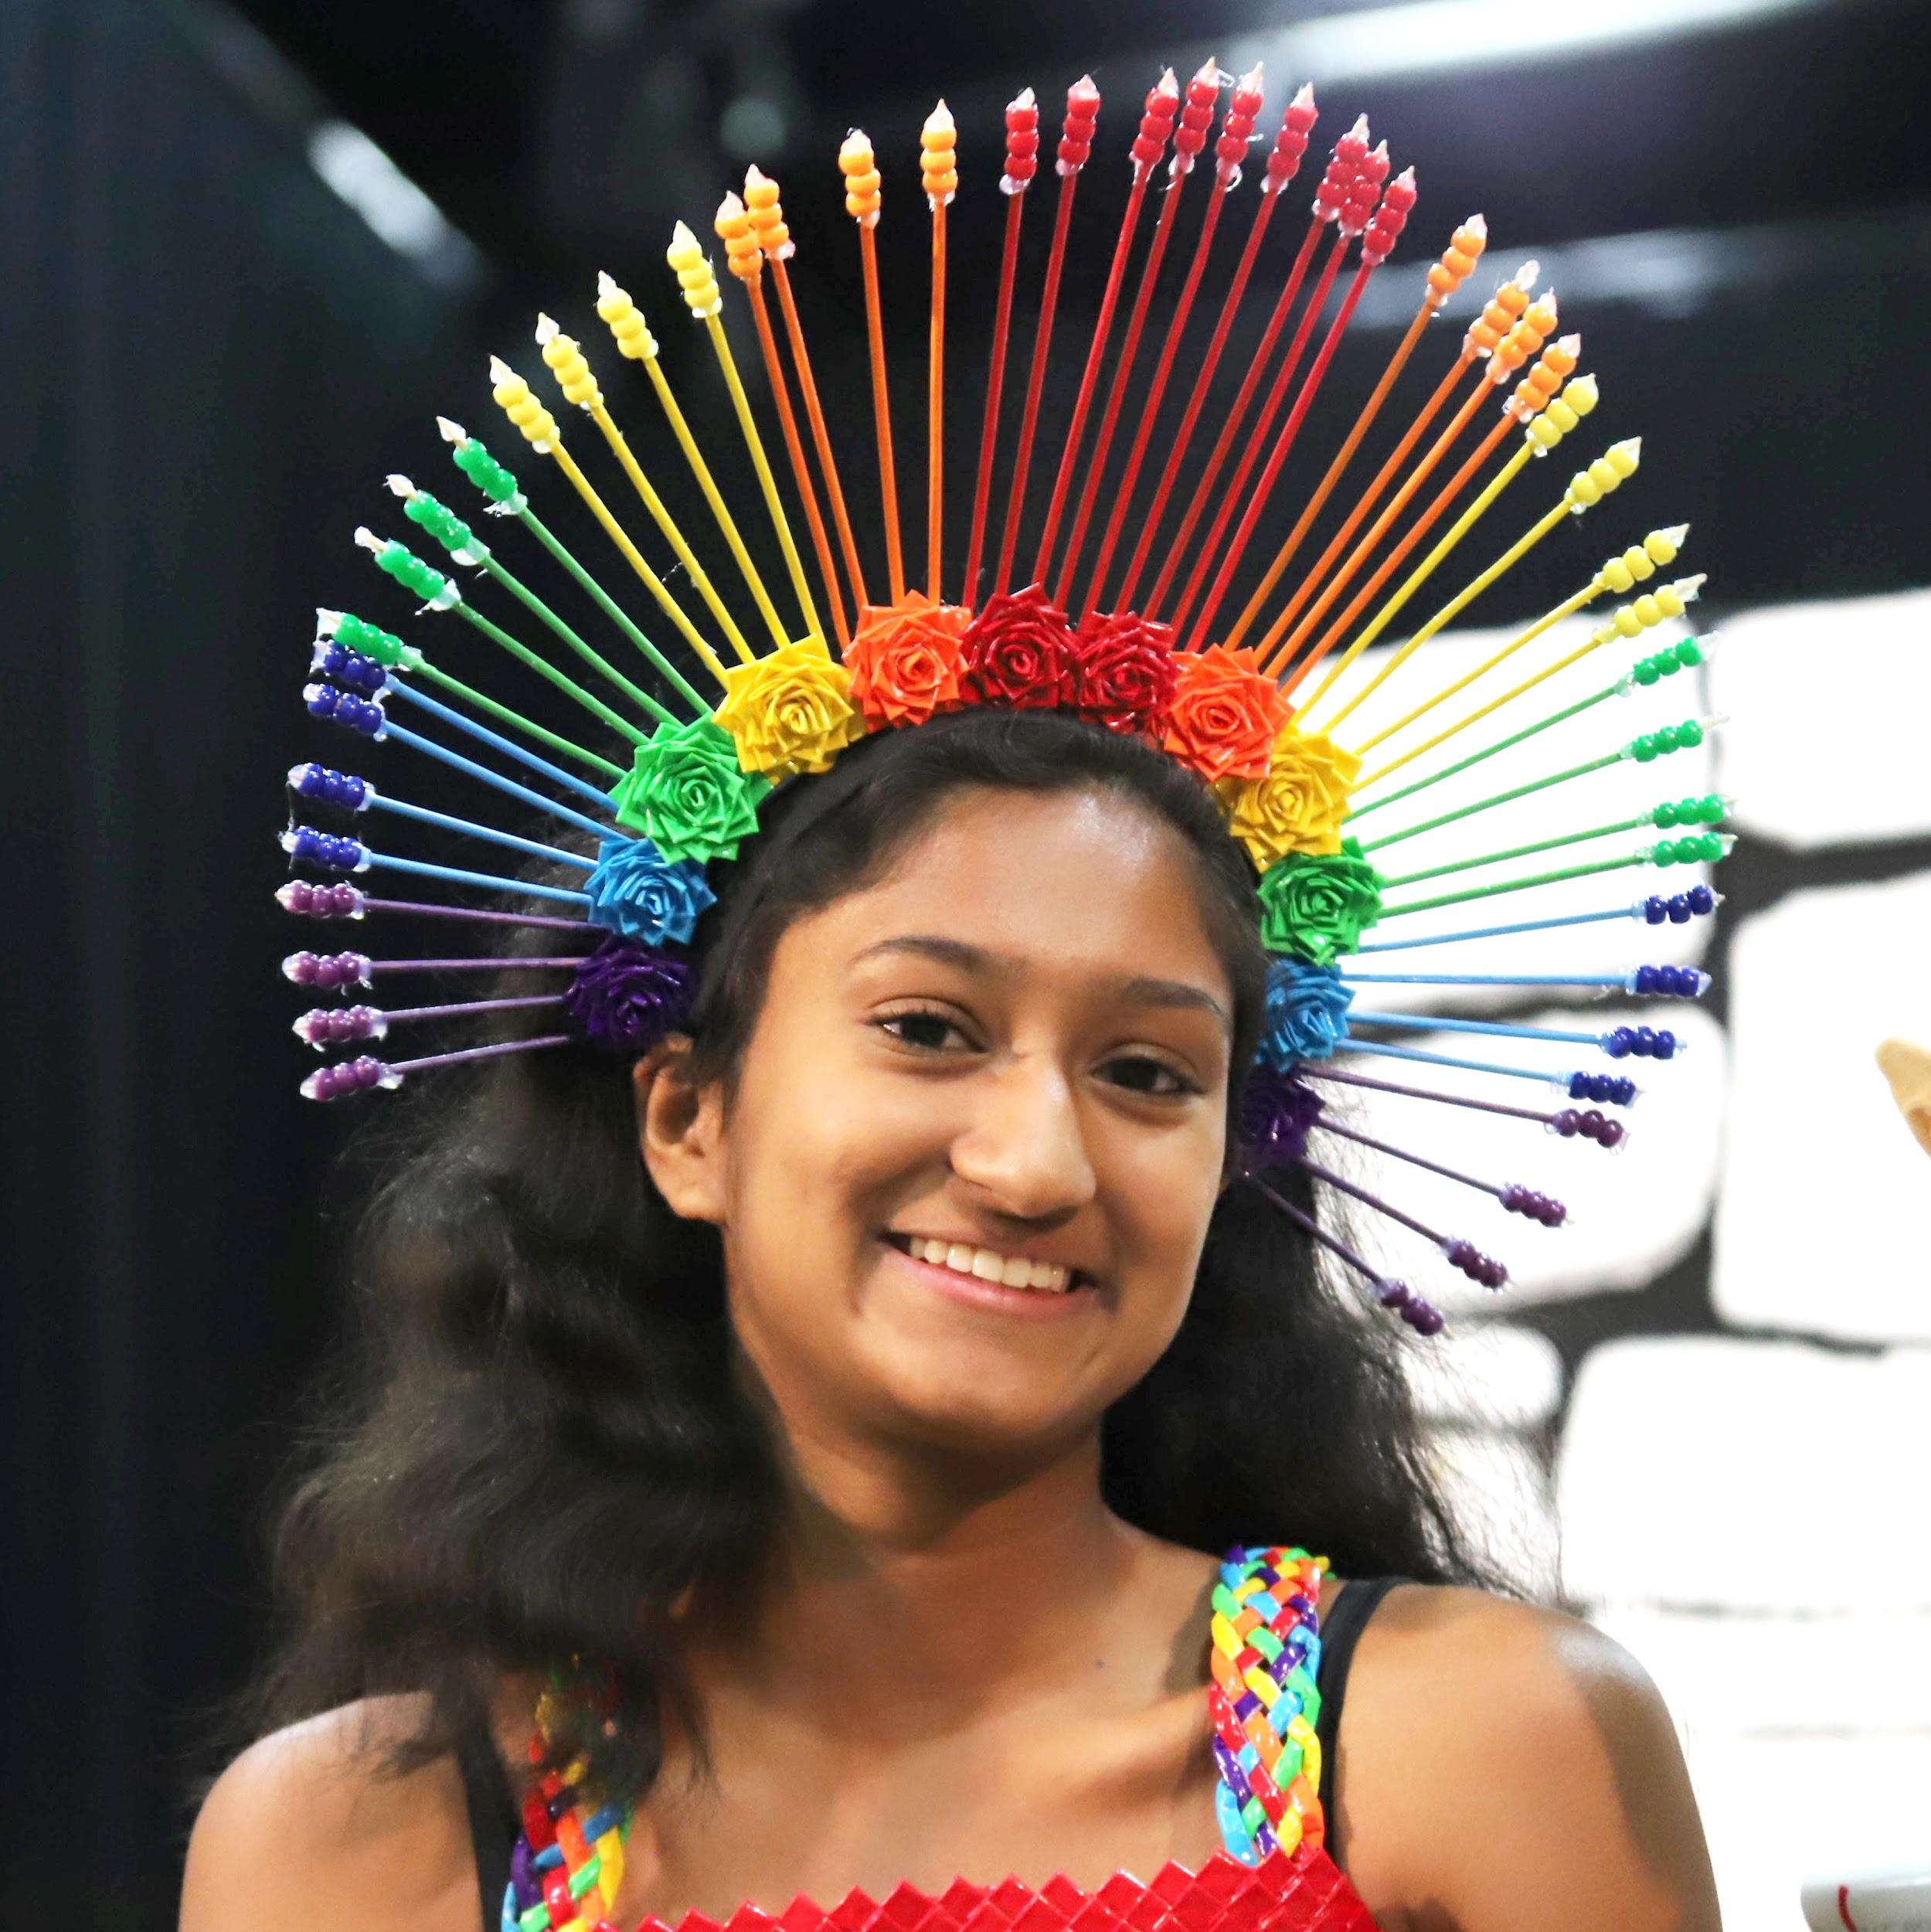
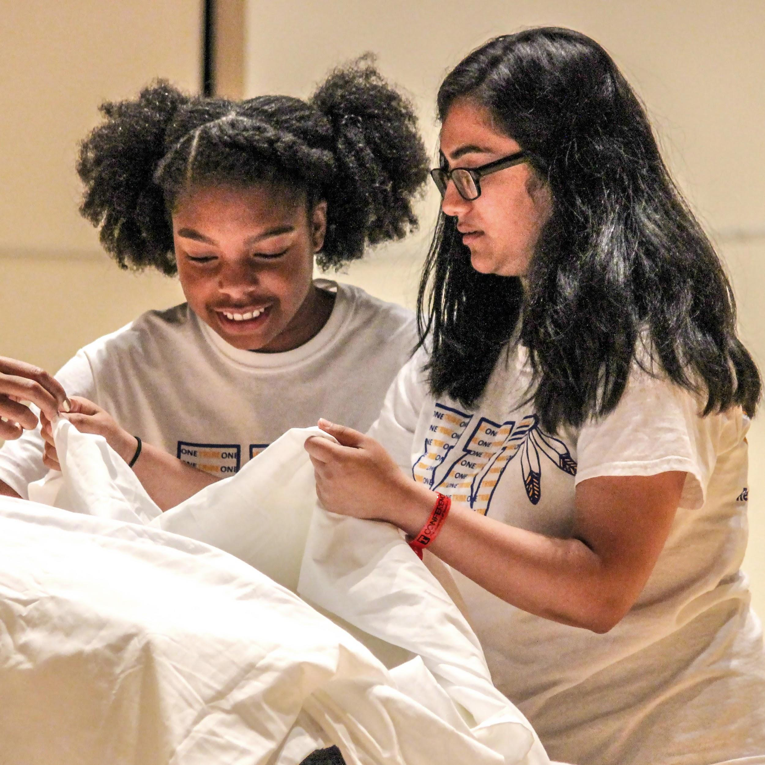
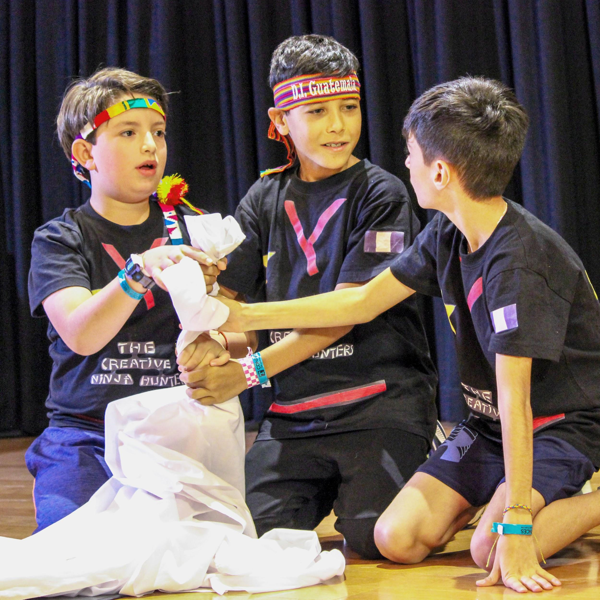
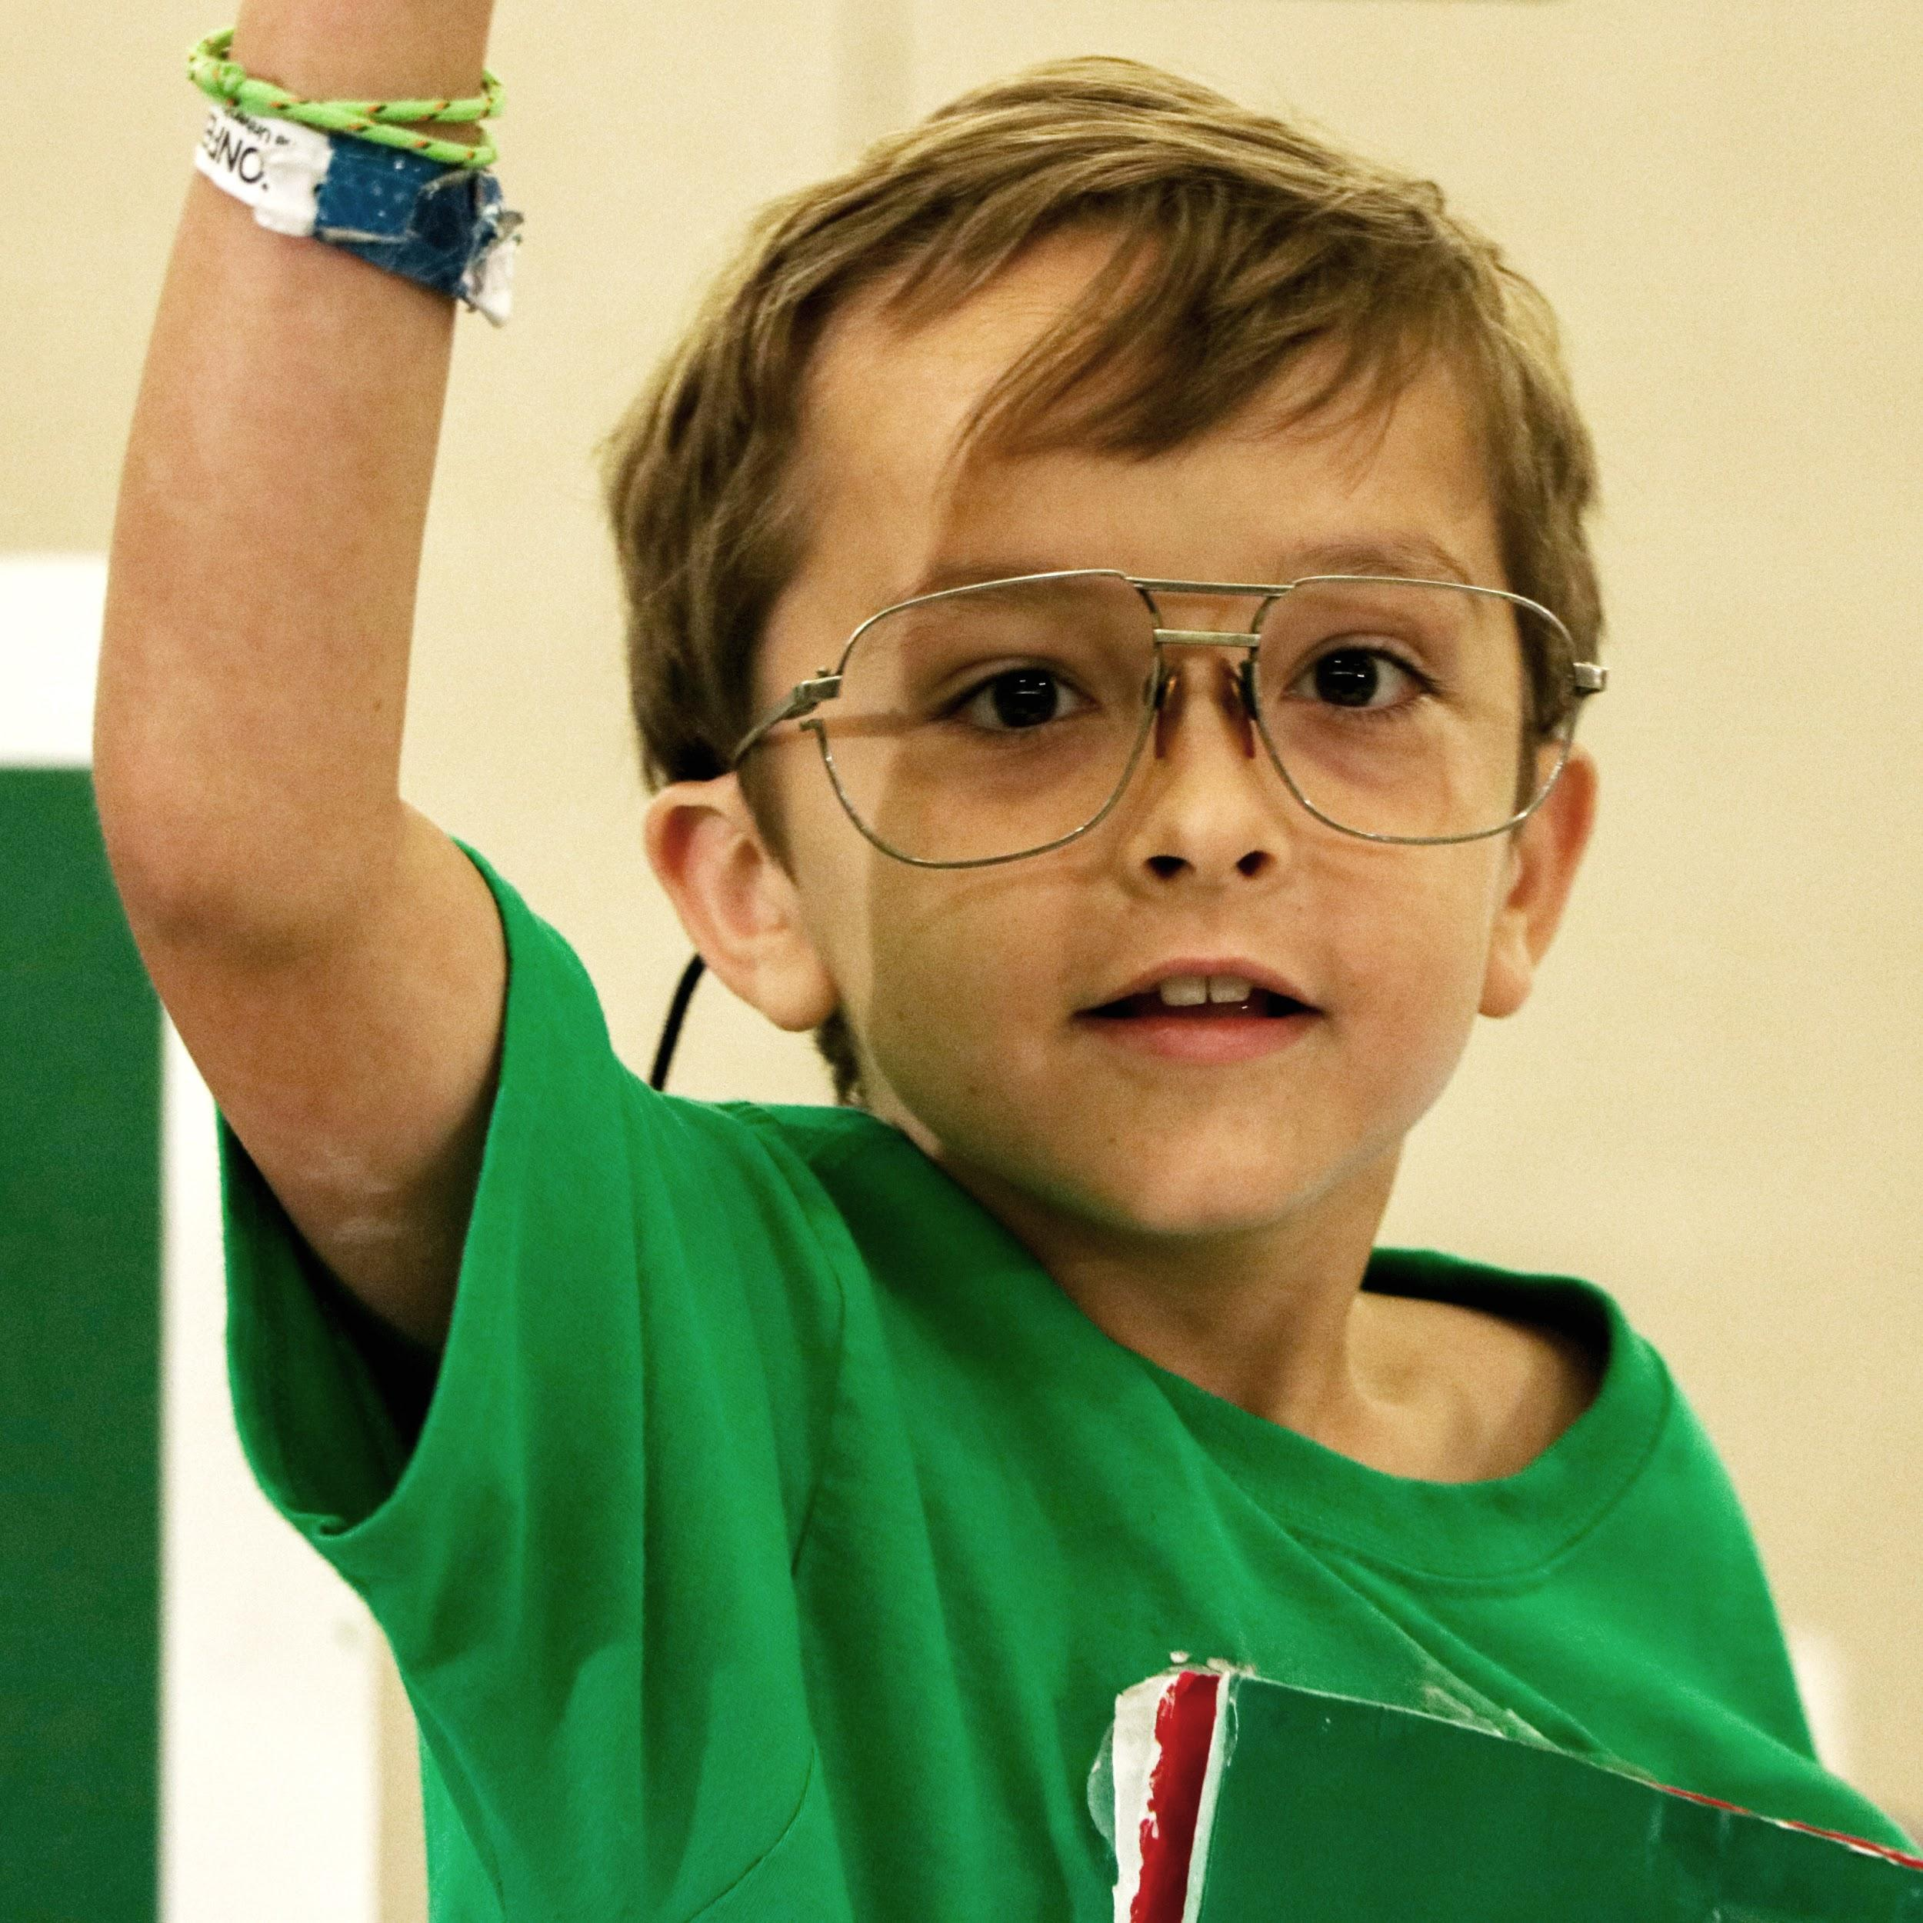
TEAM FUNDRAISING
Getting Started
Doing DI can be one of the most enriching and extraordinary experiences for a team to have. From learning new skills to creating your own solutions to seriously tough Challenges – there’s no better way to get all the most important skills you’ll need for future success.
However, doing DI does cost money. From purchasing a Team Number, to the cost of materials and travel to tournaments, it can add up quickly.
That’s why DI wants to help every team think through and develop an actionable fundraising plan that will help you gain the critical community support your team needs in order to fully participate in DI.
We hope you find this presentation helpful!

Slide 4
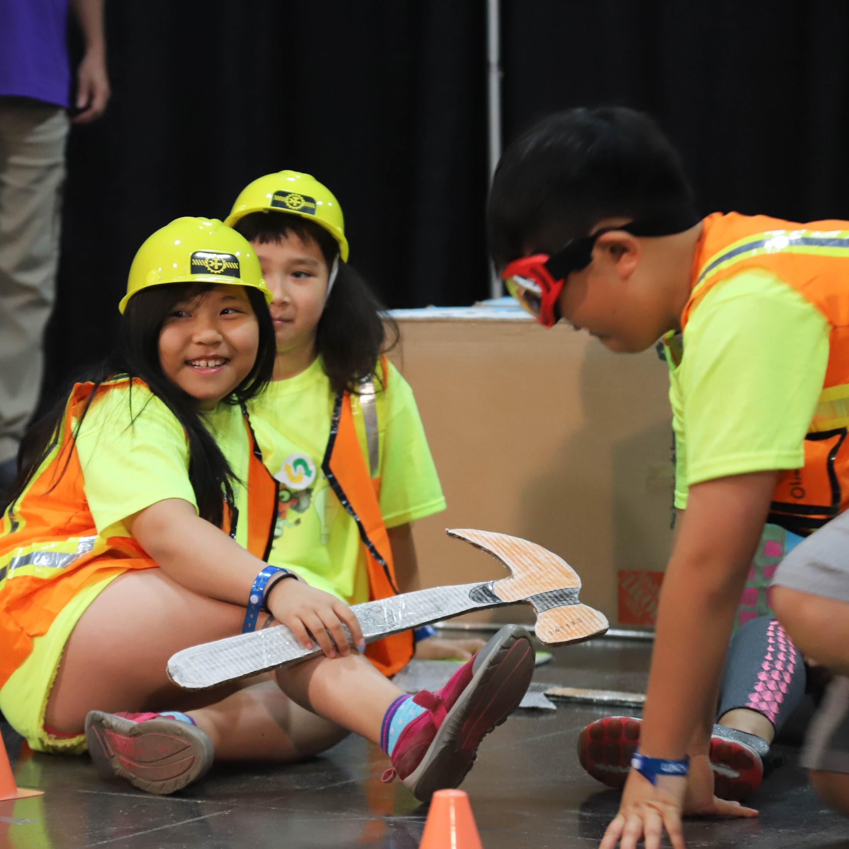
TEAM FUNDRAISING
Building a Team Budget
Think about the different parts of the season that require funding:
Developing your team’s solution (August – January)
Attending skills workshops or field trips to learn new things
Attending Regional (Provincial), Affiliate and (possibly!) Global Finals tournaments
Thanking and recognizing your supporters

Slide 5
TEAM FUNDRAISING
Building a Team Budget
Make a list of all the expenses your team may have. Be thorough! Some expenses that you may want to consider include:
Registration fees
Materials
Team Expenses
Travel, room and board
Website hosting
Thank you cards/gifts for supporters

Slide 6
TEAM FUNDRAISING
Ways to Fundraise
There are lots of ways you can raise money for your team. Some of those ways include:
Finding community support
Use a crowdfunding website
Holding fundraising events
Applying for grants
Seeking out corporate sponsors

Slide 7
TEAM FUNDRAISING
Keep Good Records
Make sure you are tracking all of your expenses throughout the season. You can use simple tools like Microsoft Excel. You can even get a parent or supporter to help you keep track of your expenses and fundraising activities since that is not considered to be Interference.
Make sure you are making regular updates to your income and expenses so that your teams always knows where you stand financially.
You’ll also want to develop a process for changes you make to your expenses and fundraising activities as the season progresses.
Review your program at the end of the season to understand what worked and what didn’t so that you can refine your process for the next year!

Slide 8
PART II – PLANNING

Slide 9
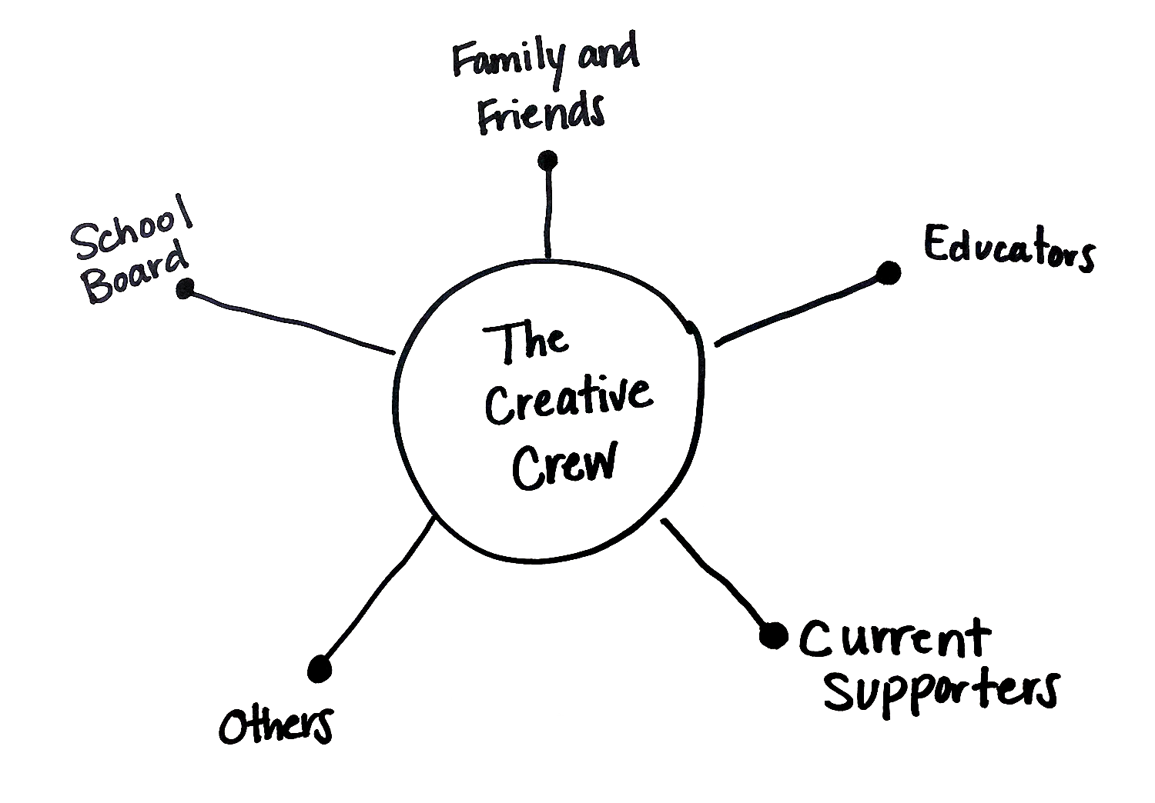
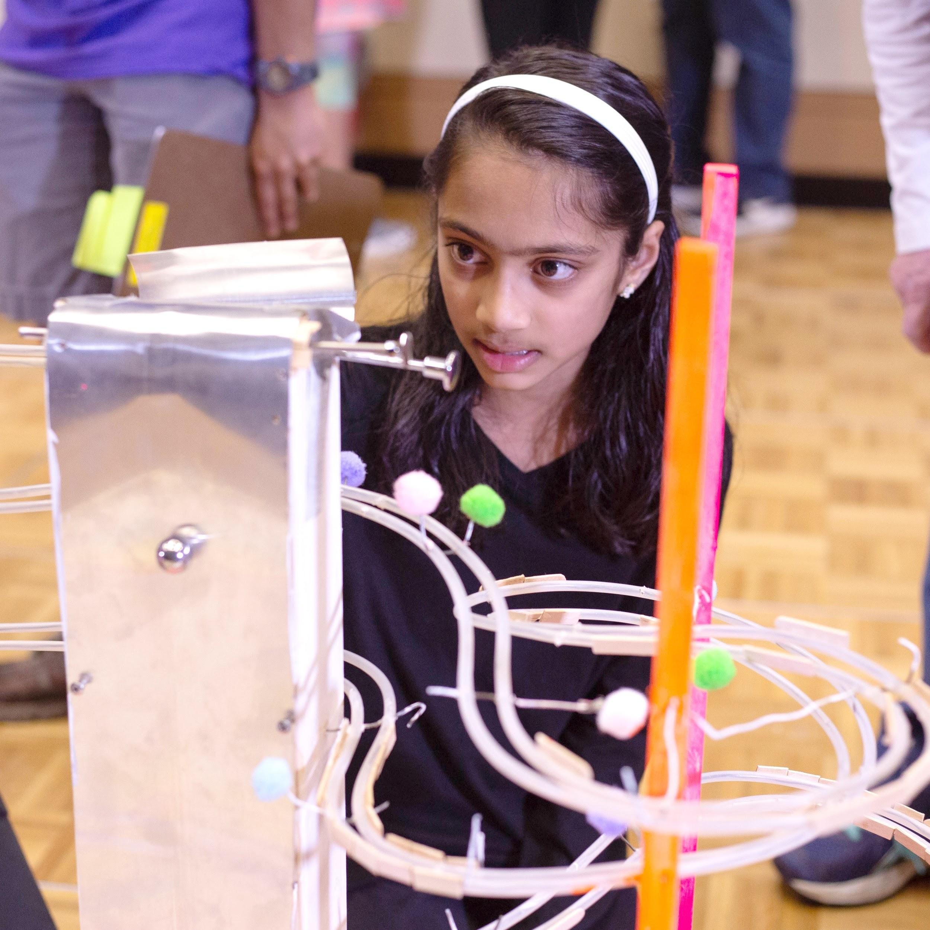
TEAM FUNDRAISING
Planning
Notes:
Create a resource map– how you can take advantage of your relationships and connections to help fundraise for your DI team.
Write your team name in the center of a piece of paper or white board.
Then, explore and record who you are already connected to. This can be other students, educators, family, friends, current supporters
Then, ask and answer this question: what resources do our existing connections have?

Slide 10
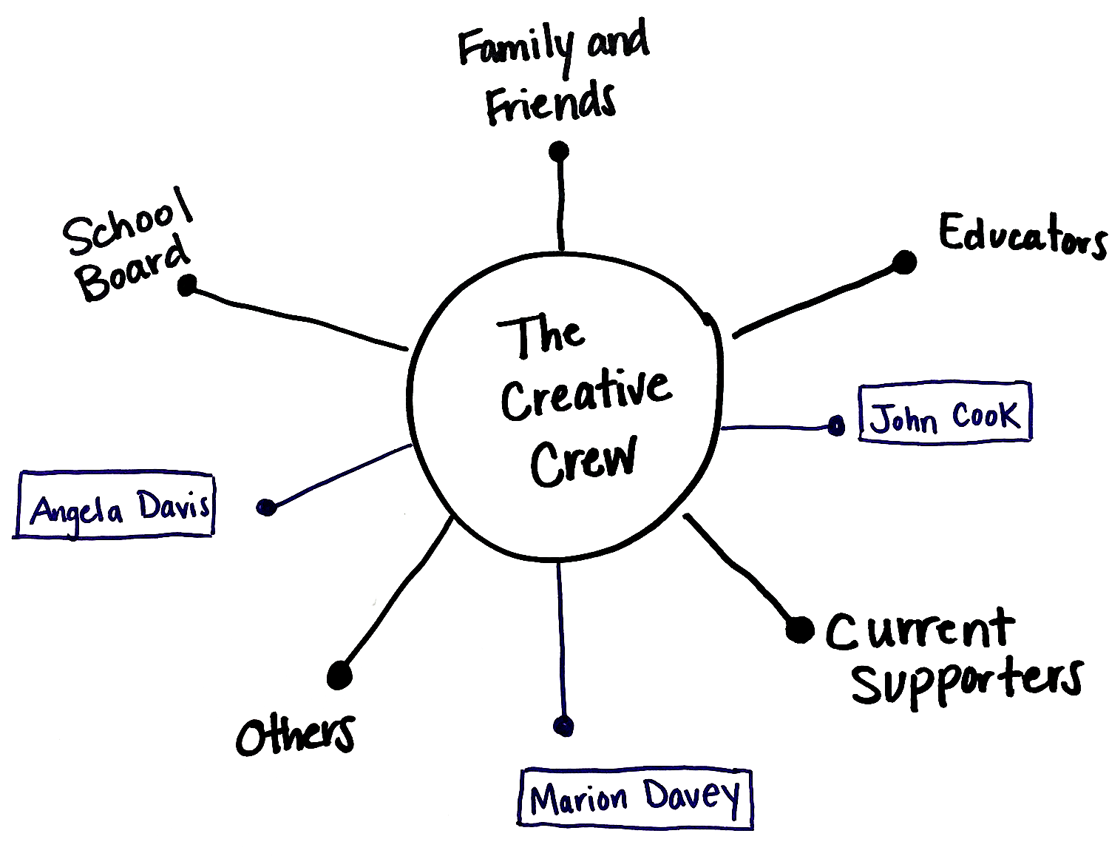
TEAM FUNDRAISING
Planning
Notes:
Think beyond money – Maybe they’ve been volunteers, maybe they have a large social media following

Slide 11
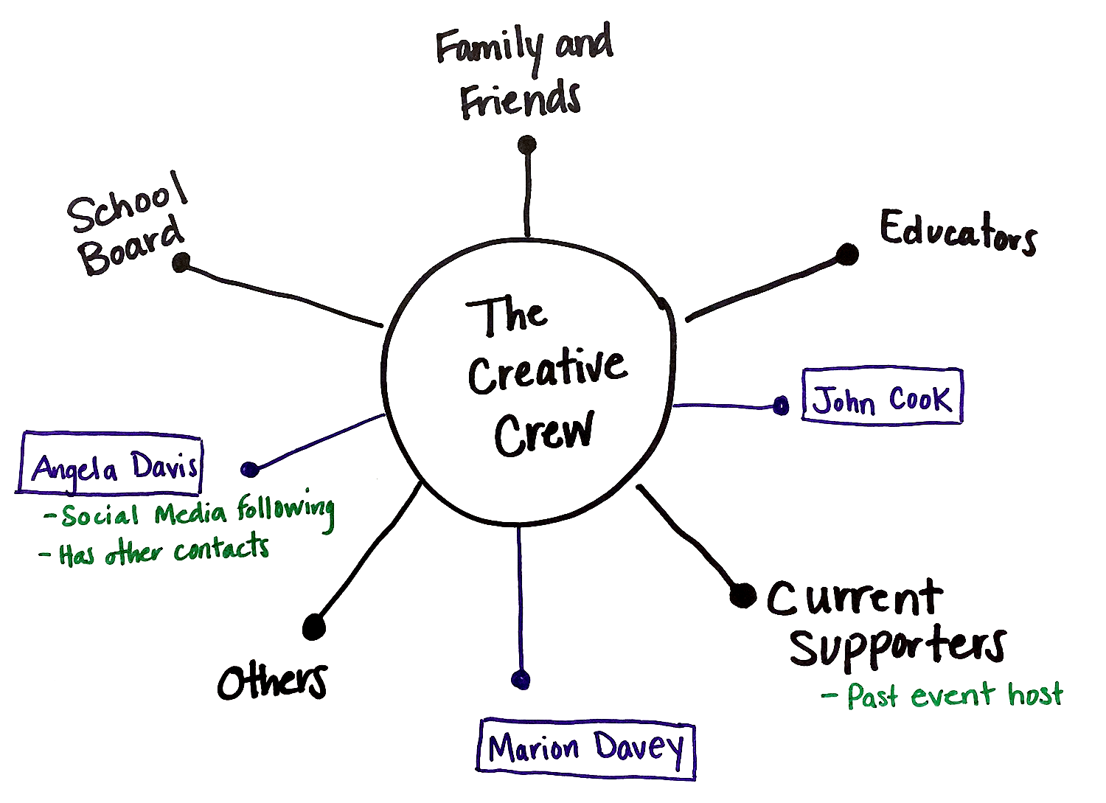
TEAM FUNDRAISING
Planning
Notes:
Maybe they have other contacts that could help your team
Maybe they’ve helped you put on a fundraising event in the past
Then ask: “who would you like to develop a relationship with?” Think about the connections you do have and how they might be connected to others you’d like to know but don’t know yet.

Slide 12
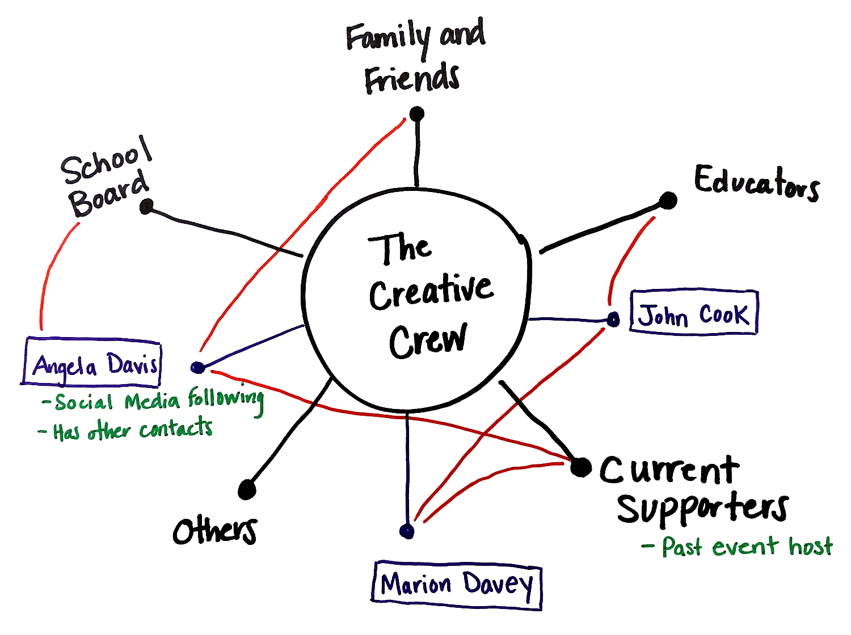
TEAM FUNDRAISING
Planning
Notes:
For example – The head of a company that you’d like to reach out to attended the local University that you are already have a relationship with in some way.
Once you’ve spent time brainstorming on all your existing relationships, the connections you’d like to make and how these to groups might have connections to each other - you can connect the dots

Slide 13
TEAM FUNDRAISING
Planning
Once you’ve connected the dots, you can create a TASK LIST of WHAT to do and WHO on your team can do it in order to leverage your current connections and relationships.
Now that you have your strategic resource map, you’re ready to create your Prospect List and…
Get fundraising!

Slide 14
PART III – ENGAGING SUPPORTERS

Slide 15
TEAM FUNDRAISING
Engaging Supporters
Look at your budget
Be Realistic
Understand your pitch
Notes:
Before you start engaging your supporters and making fundraising asks, there are a few things that you should do to prepare:
1. Look at you budget and determine what your team needs. How much money do you need to reach your goal?
2. Be realistic about how much money you may raise. If you sit with your team and make a list of who you may know, who may contribute and about how much, this may give you a good foundation to start from.
3. The more you think it through and practice your pitch the better you’ll be able to communicate why you need the support and the better case you’ll make.

Slide 16
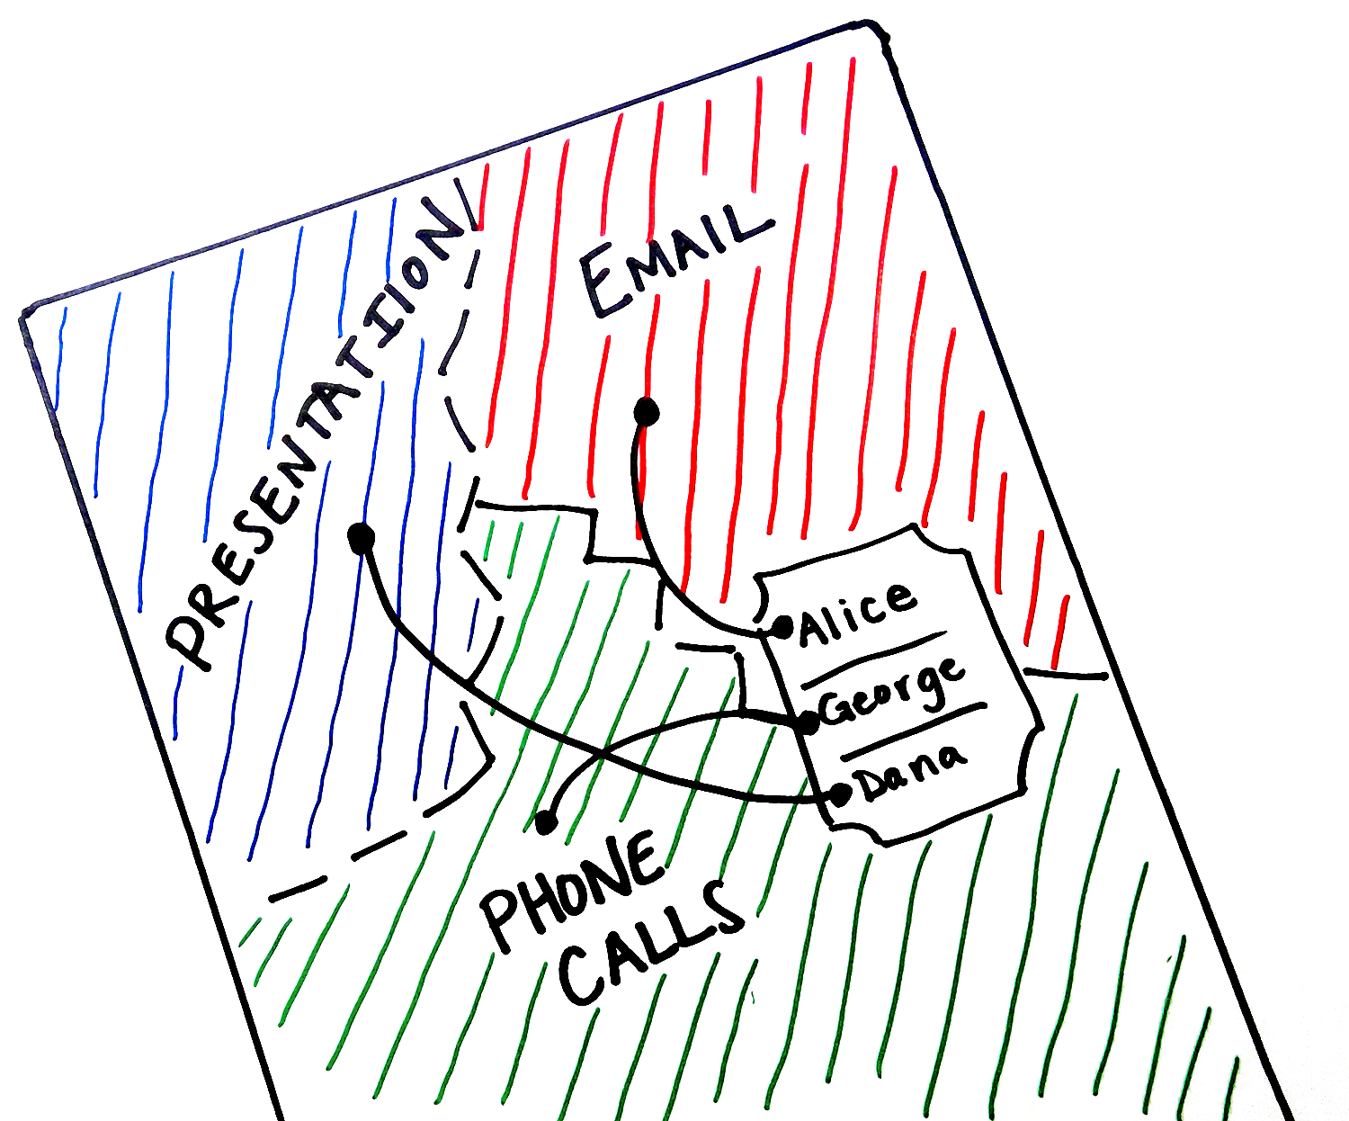
TEAM FUNDRAISING
Engaging Supporters
Notes:
Go back to your Resource Map that you created and use it to organization your team’s strategy.
Organize your team into different groups on the map and assign responsibilities to each group and each person within each group.

Slide 17
TEAM FUNDRAISING
Engaging Supporters
For each resource, create a NEEDS LIST.
Making a phone call
Sending an email
Send a letter
Setting up an in-person meeting
Applying for a grant
Reaching out in another way

Slide 18
TEAM FUNDRAISING
Engaging Supporters
You can use the DI fundraising letter template to guide what message you should include in your initial outreach to potential supporters.
You can find that template HERE.
You can also use the DI fundraising PowerPoint template to help keep your support message streamlined and professional.
You can download that template HERE.
Notes:
You may be assigned to reach out to connect with different resources.

Slide 19
TEAM FUNDRAISING
Engaging Supporters
At the end of the season, make sure you spend time review what worked and what didn’t. Ask questions like:
What was a big success?
What didn’t work well?
How could we improve for next season?

Slide 20
PART IV – THANKING YOUR SUPPORTERS

Slide 21
TEAM FUNDRAISING
Thanking Your Supporters
Ask yourself – WHY?
Why did they fund your team?
Do they have a personal connection to:
Your team
Destination Imagination
Education
Your school
Your Challenge solution

Slide 22
TEAM FUNDRAISING
Thanking Your Supporters
Ways to thank someone can include:
A personal, hand-written note
Social media shout out
Signed photo of the team
In-person thank you
What other ways can you think of that are not listed here?
Notes:
Based on previous interactions, think about how they might like to be thanked for their support.
Consider what will be most meaningful to your supporter.

Slide 23
TEAM FUNDRAISING
Thanking Your Supporters
What to include in your thank you message:
Think about what kind of opportunities their support created:
Materials
Travel
Room/board
How would your season have been different or more challenging had you not received your supporter’s help? Include that in your message as well.

Slide 24
TEAM FUNDRAISING
Thanking Your Supporters
Supporters like to see young people learn and hearing about those lessons. So, think about the top 2 or 3 lessons or insights your team learned this season. Topics might include:
Teamwork
Creativity
A new skill (like sewing, welding or computer coding)

Slide 25
TEAM FUNDRAISING
Thanking Your Supporters
Some additional pro tips:
When you thank your supporter, make sure you address them by name – no matter how you decide to thank them.
Let them know what their gift did for your team and how it allowed your team to grow as a result.
Consider sharing a story from your season that you supporter might like to hear about.
Have everyone on your team sign the thank you, including your Team Manager(s)

Slide 26
TEAM FUNDRAISING
Thanking Your Supporters
Your past supporters are often your future supporters.
So, invite your supporters to events throughout the year so that they can feel more connected and engaged with your team’s DI experience.
Events to invite them to:
Host an Instant Challenge blitz where your supporters can get in on the fun and try an IC or two
Tournament dress rehearsal
Team field trip (museum or fun outing)
Regional/Affiliate tournament/Global Finals

Slide 27
TEAM FUNDRAISING
Thanking Your Supporters
Also, think about how you can share stories with your supporters about the progress your team is making throughout the season.
Keep communicating through social media
A phone call
Or personal message
You don’t want your supporters to only hear from you when you need help.

Slide 28
TEAM FUNDRAISING
Good Luck!
We hope you’ve found this presentation to be helpful and that you can use some of these tools and techniques to develop strong relationships with your supporters!
Let us know how you’re doing. Reach out and share your fundraising success stories at advancement@DIHQ.org.

Slide 29
Thank you and good luck! Let us know about your success at advancement@DIHQ.org

